Slide 1

RouteGuard
InCode 2023
Theme : Safety
Your Trusted Guardian on the Road!
Akanksha Sharma
Navdeep Kaur

Slide 2
Problem Statement
In the context of ride-hailing services, a significant and pressing problem lies in ensuring the safety and security of passengers, particularly women, passengers traveling with children, and drivers. Traditional transportation systems often overlook the unique safety concerns faced by these specific user groups. Instances of harassment, assault, or unexpected deviations from the intended route can pose severe risks to the well-being and peace of mind of both passengers and drivers. Consequently, there is an urgent need to develop innovative solutions that prioritize the security and protection of these vulnerable users.
Our objective is to address this problem by enhancing ride safety for millions of users. By doing so, we aim to create an environment where these individuals feel empowered, secure, and confident throughout their rides, fostering trust and reliability within the transportation ecosystem.

Slide 3
The Solution
RouteGuard combines intelligent route monitoring and real-time notifications to keep you protected from potential risks and deviations
As you embark on your ride, our system meticulously tracks the driver's route, comparing it to the optimal path determined from your source to destination.
In case of long duration of off-route driving,rather than triggering unnecessary alarms, we ensure seamless communication by sending a discreet warning notification directly to your smartphone.
At your fingertips, you have the freedom to choose the most appropriate response.
Our mission is simple:
To reduce risks, enhance safety, and empower passengers like never before.

Slide 4
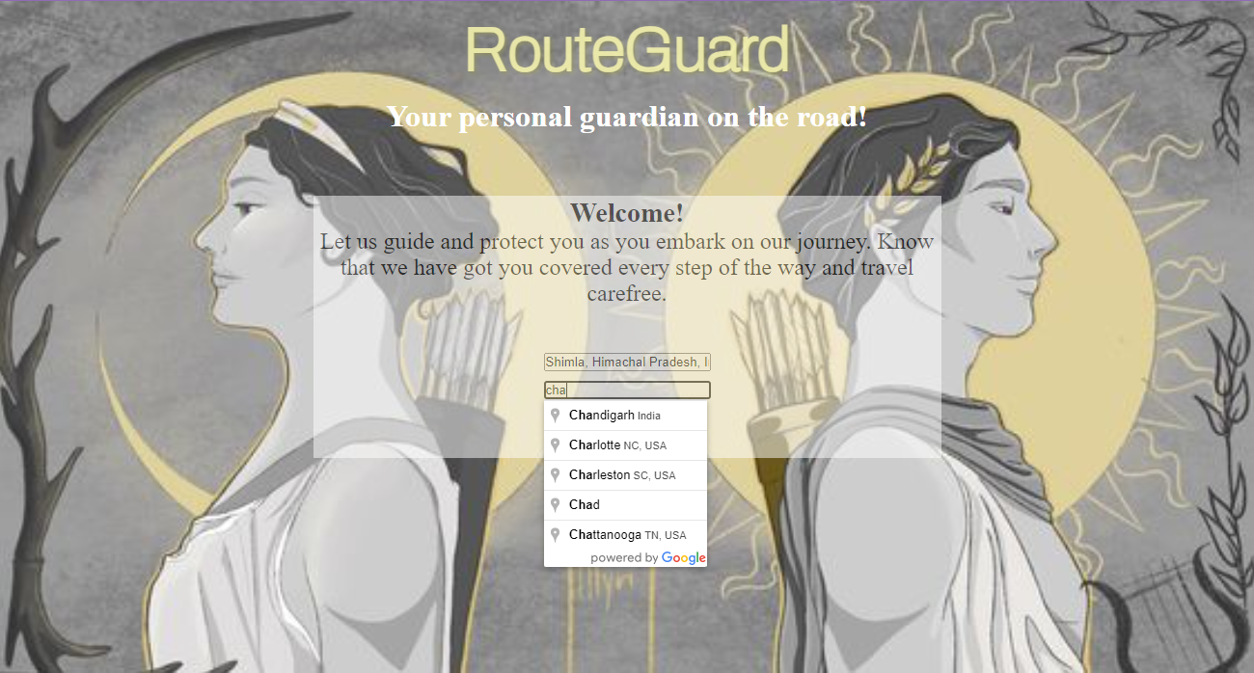
The Design: Our design is inspired by the Greek goddess of war Athena ,who is a strong protector and sun god,Apollo who represents light and radiance.Together they instill a sense of security by illuminating the righ path and offering protection in it.
Location Permission:
Asks user for permission for location detection to ensure privacy.
Entering Destination: The locations are verified using Google Maps API in order to ensure verification and proper coordinates.

Slide 5
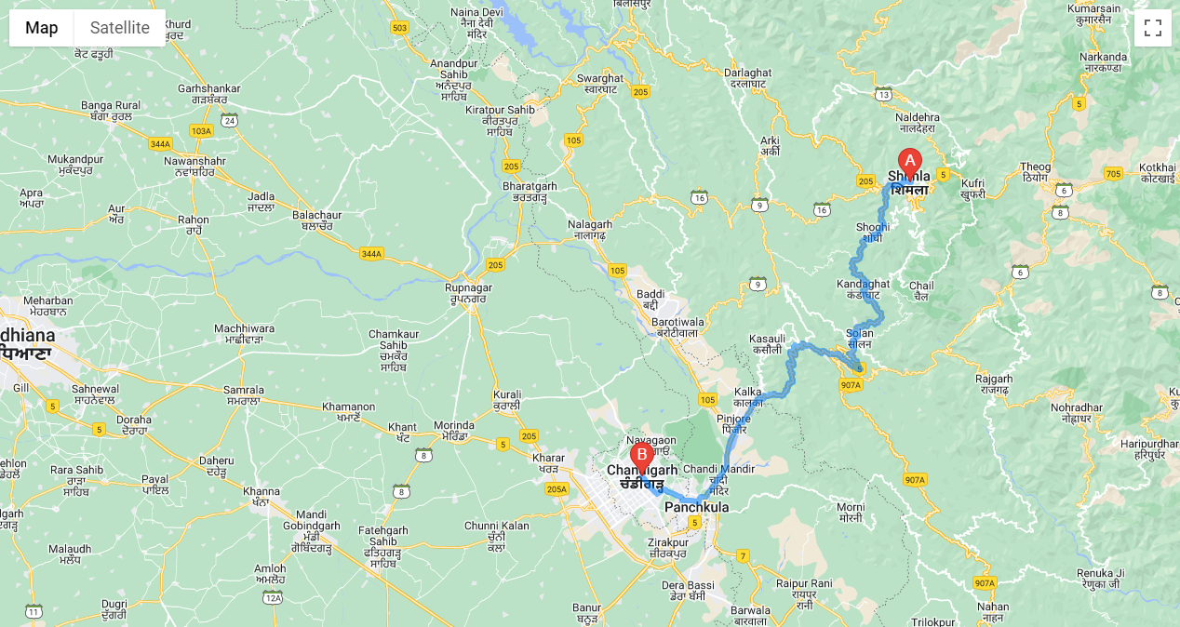
Optimal Route Finder: Based on current conditions,it finds an optimal route between the user’s current location and destination.
Zoom In/Out : The user can zoom in/out the maps as per their preference.
Markers: The website marks the destination and current loction with markers to make visualization easier.

Slide 6
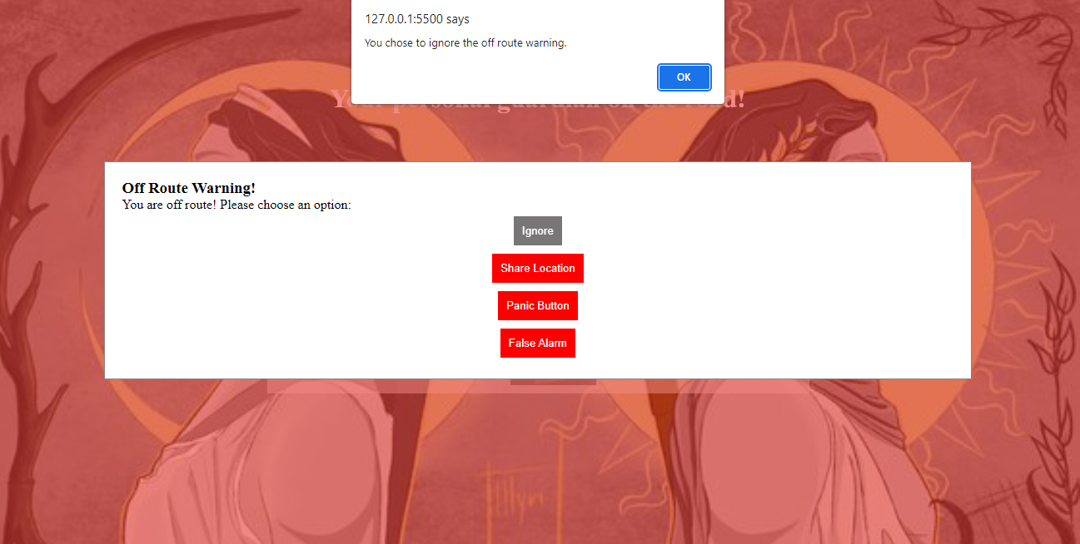
Off-Route Warning: On being off route for long time and sends a warning to user and alerts them.Checks off route by checking location within a time span of 30sec regularly and comparing it to optimal route using Distance Matrix API.
User Empowerment: They can choose best course of action as per the situation
Recording Action:
Counting no of warnings and ensuring safety and analyze driver’s credibility

Slide 7
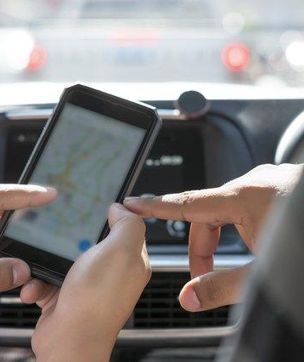
Plus Features:
Easy integration with any existing ride hailing platform(use of google maps API)
Requires minimal input from the user
Works on both laptop and mobile phones
Immersive design
Easy to navigate
Disceret warnings
Range of options

Slide 8


Team Roles and Competencies
Akanksha
(Python, UI/UX, Frontend development)
Successfully created a working prototype of the shortlisted idea
Made a visually attractive and responsive website
Successfully integrated required APIs
Great teamwork and coordination
Ability to handle pressure and manage time effectively
Navdeep
(Frontend and Backend development)

Slide 9

Future Plans
1.Create a database corresponding to the feature:
Store no of warnings issued in reference to drivers which would help to analyze credibility
Store locations subject to frequent detours
2.Perfect the warning system using machine learning models to minimize false positives.
3.Improve further based on user feedback.

Slide 10

RouteGuard
Because your safety is our priority!

